Slide 1
Naive bayes

Slide 2
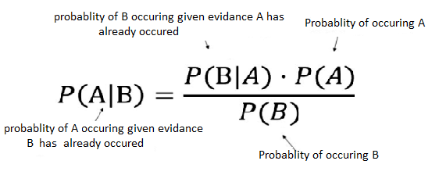
Naive Bayes is a probabilistic machine learning algorithm. It is used widely to solve the classification problem.
The Naive Bayes algorithm is based on the Bayes theorem. Which is given below.
In simple terms, the Bayes theorem is a way of finding a probability when we know certain other probabilities. From the formula, we can clearly infer that the probability of B has already occurred to determine the probability of A.

Slide 3
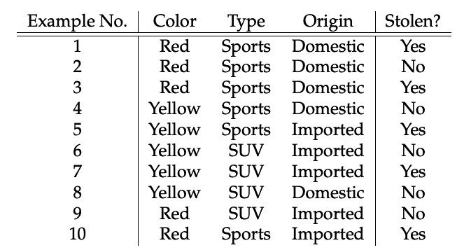
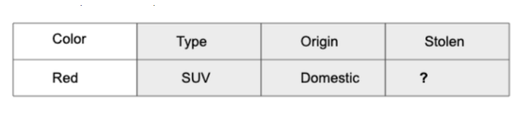
Consider dataset where car color type and origin is given and car is stolen or not from given data set.
Question is given that car will be stolen or not and we will try to find answer with naive Bayes algorithm

Slide 4
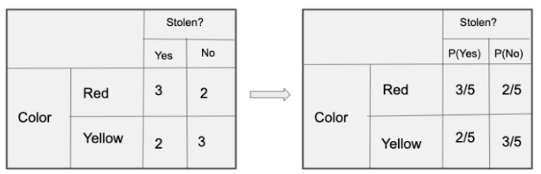
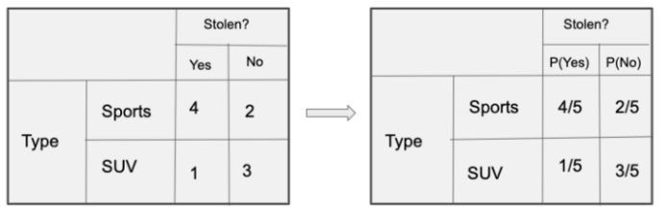
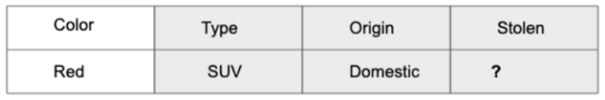
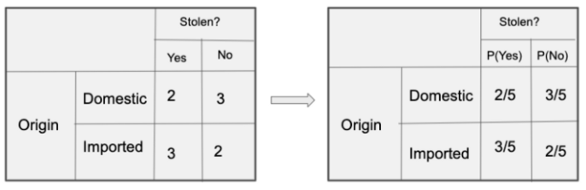

Slide 5
today = (Red, SUV, Domestic)
To determine car is stolen ‘YES’
P(Yes|today) = P(Red|Yes) * P(SUV|Yes) * P(Domestic|Yes) * P(Yes)
__________________________________________
P(today)
To determine the car is not stolen ‘NO’
P(No|today) = P(Red|No)*P(SUV|No)*P(Domestic|No) * P(No)
__________________________________________
P(today)
Since P(today) is common in both probabilities, we can ignore p(today) and find probabilities :
P(Yes|today) = 3/5*1/5*2/5*1 = 0.048 (aane equation ma change karvu image next slide ma aapeli chhe a mujab)
P(No|today) = 2/5*3/5*3/5*1 = 0.144 (aane equation ma change karvu image next slide ma aapeli chhe a mujab)
Here 0.144 > 0.048, Which means car is not stolen.

Slide 6
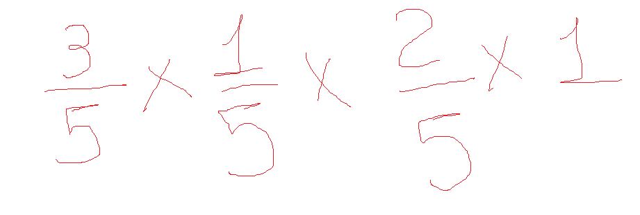
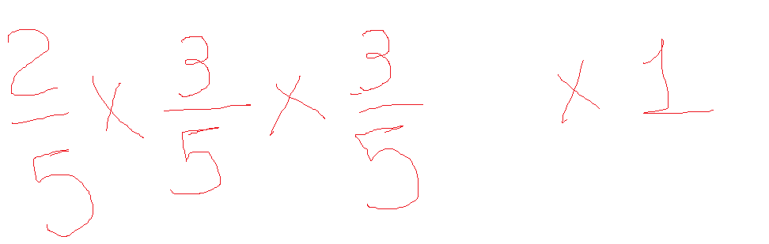
Uper ni ppt ma lal akashare note aapi chhe

